Slide 1
Protein design through discrete diffusion
Gijs Admiraal

Slide 2
Content
Problem statement
Data analysis
SELFIES vs SMILES
Functional groups
Discrete diffusion process
T5 architecture
Initial results
Notes:
First let’s start with the data analysis part

Slide 3

What are proteins
Large macromolecules
Long chains from 10s – 1000s of amino acids
Function ranges from structuring cell to aiding immune system
Sequence => Structure => Function
Notes:
So okay that is nice but why do we need to generate or design these

Slide 4
Why protein design
Proteins are a ubiquitous tool for life
Search space is vast
Computational method accelerate
Generative models help with design
Notes:
Proteins come in many shapes and forms and can be expressed as structure or sequences

Slide 5

Why sequence design?
Function is derived from structure
(Inverse) folding
Scarcity of high-quality structural data
Notes:
Now that we have established why we wanted to do this, why do we want discrete diffusion?

Slide 6

Why discrete diffusion for sequence modelling?
Has seen large success across various fields
Outputs are faster and diverse
Discrete diffusion allows for parallel generation
More token-level control
Inpainting allows to complete uncomplete sequences
Notes:
Let’s look at my dataset

Slide 7
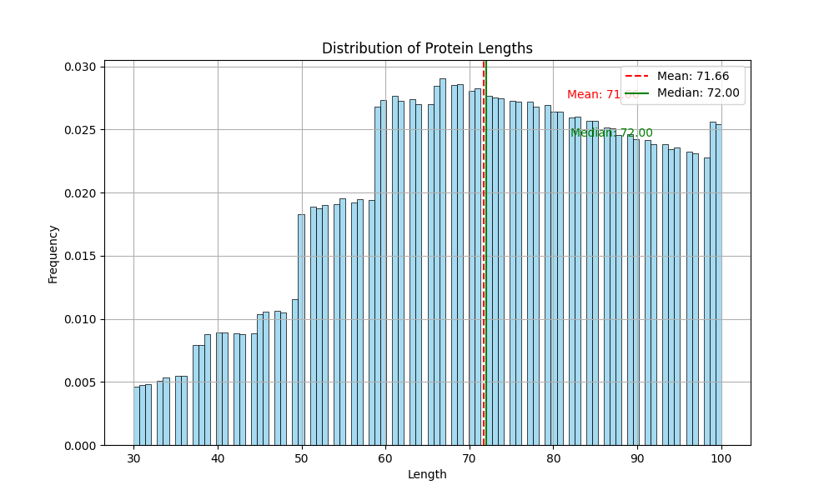
UniRef50
Filtered for sequence length: 30-100
Created a training/validation/test split (0.8/0.1/0.1)
AA sequence
Vocabulary: 20
Lengths: 30-72-100
Atom sequence
Vocabulary: 21
Lengths: 402-967-1343
F-group sequence
Vocabulary: 15
Lengths: 47-115-160
Notes:
As you can see most proteins lengths are distributed around length 70.
How does the distribution of amino acids look for different length

Slide 8
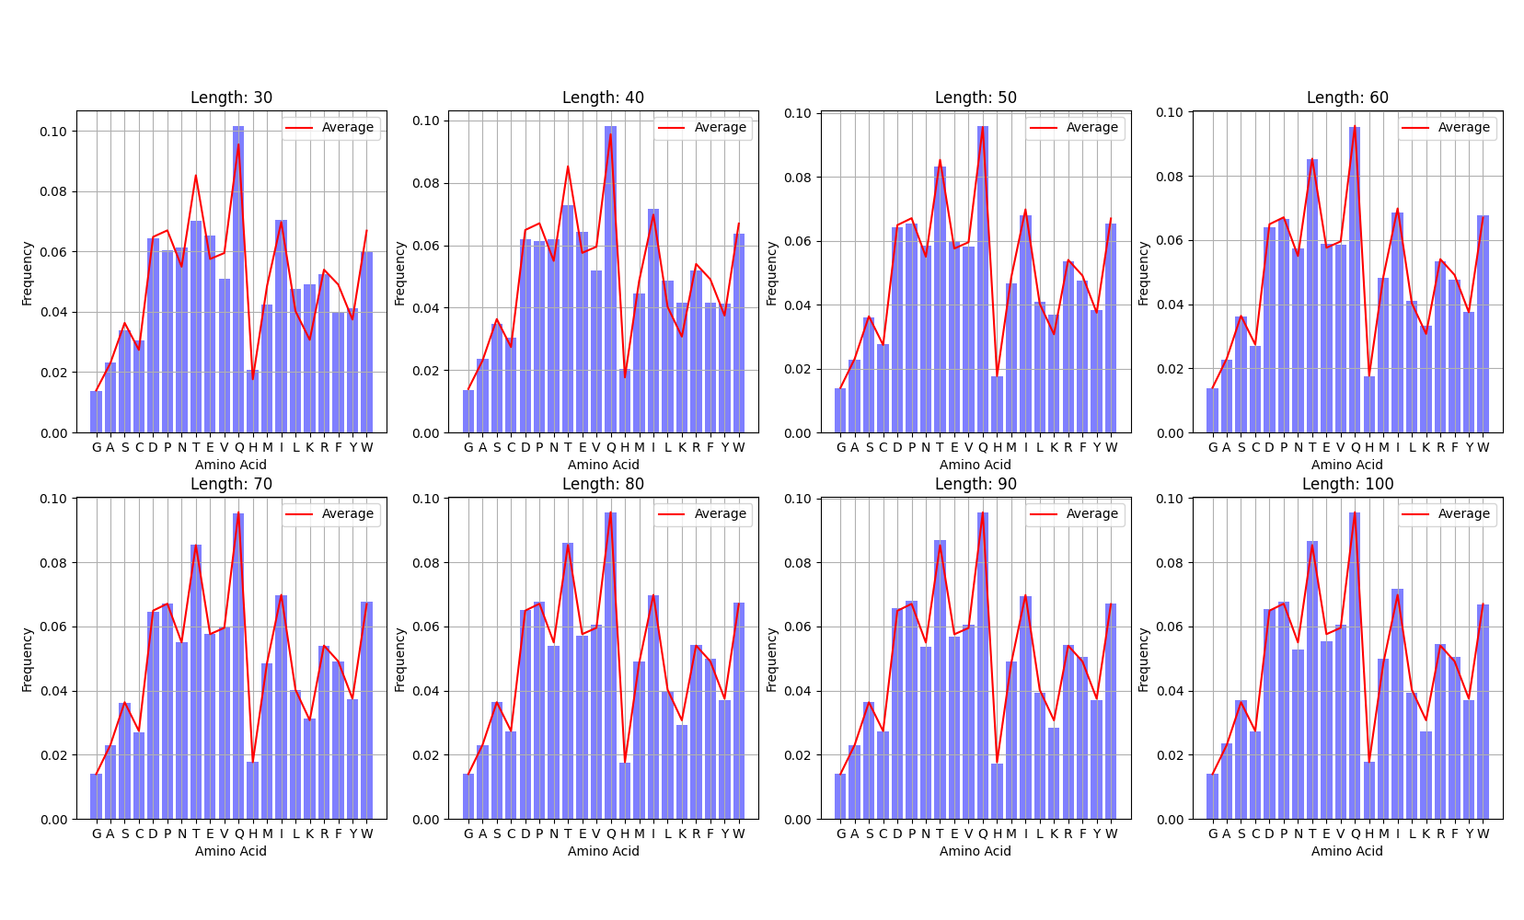
UniRef50
Average line is across all sequence lengths
Amino acids sorted on molecular volume
Length 70 most like average frequency distribution
Notes:
One nice addition could also be to look at the range of different lengths for going from amino acids to SELFIES for example
Talking about SELFIES let’s go the next slide

Slide 9
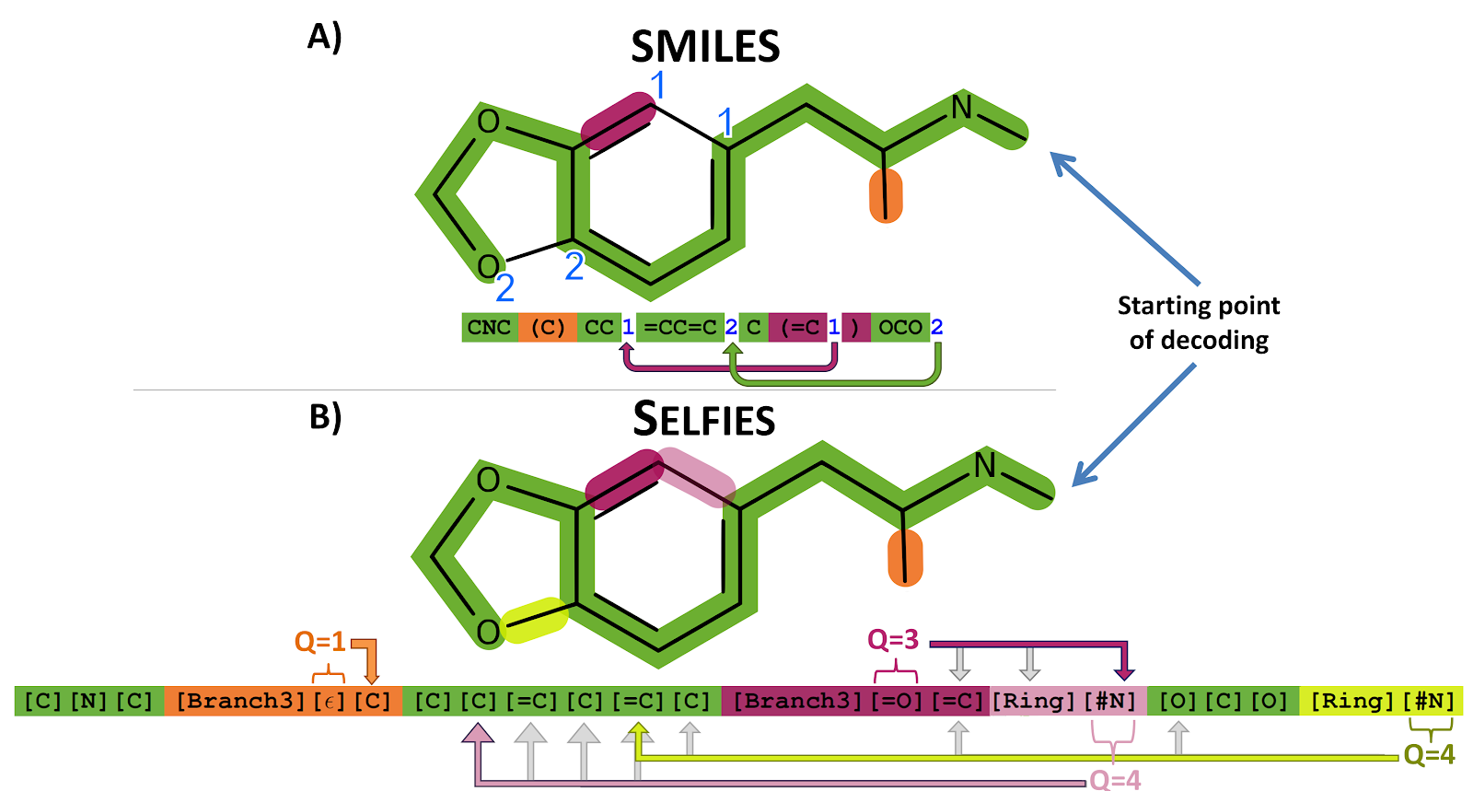
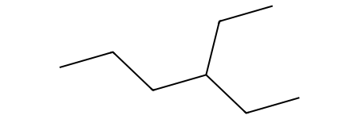
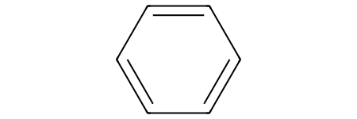

SELFIES vs SMILES
SELFIES was developed specifically for generative tasks
Designed as a formal grammar that is 100% robust
Vocabulary:
[#Branch1], [Branch1], [#C], [=O], [O], [C@@H1], [Branch3], [=C], [=Branch2], [C], [#Branch2],
[=Branch1], [C@H1], [NH1], [P], [N], [Ring2], [S], [=N], [Branch2], [Ring1]
Examples
[C][C][C][C][Branch1][Ring1][C][C][C][C]
[C][=C][C][=C][C][=C][Ring1][=Branch1]
Limitations
Crystal/grid structures and stochasticity
Generated molecule not always desired
Use RDKit and SELFIES packages
Notes:
- Overloading results in that a token (or a function during programming) behaves different depending on context
- SELFIES generates canonical molecule strings and can thus not support data augmentation
- Let’s move onto to functional groups

Slide 10
Functional groups
Functional Group Algorithm¹ – How are the groups found?
Mark all hetero atoms in a SMILES string (not a carbon or hydrogen atom)
Mark “interesting” carbon atoms
Dependent on their bonds, connected atoms or part of specific rings
Merge all connected marked atoms to a single FG
Extract FG
Vocabulary:
[CNC(C)=O], [CC(=O)N(C)C], [CNC], [CN], [CC(=O)O], [cnc], [CN(C)C(C)=O], [CO], [cO], [CS], [CC(N)=O], [CNC(=N)N], [CC(=O)NC], [CSC], [c[nH]c]
Logically what are the functional groups of amino acids?
Looks a lot like each side chain is its own functional group
Notes:
I might switch this to finding motifs/reoccurring patterns in the SELFIES representation
Now onto discrete diffusion

Slide 11
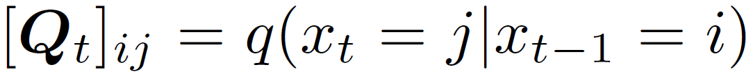
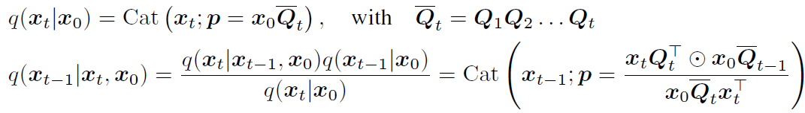
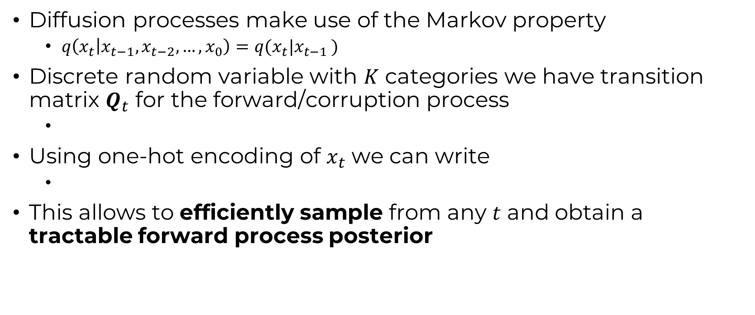
Discrete DDPM (D3PM)
Diffusion processes make use of the Markov property
$q\left(x_{t} | x_{t−1},x_{t−2}, …, x_{0}\right)=q(x_{t}|x_{t−1 })$
Discrete random variable with $K$ categories we have transition matrix $Q_{t}$ for the forward/corruption process
Using one-hot encoding of $x_{t}$ we can write
This allows to efficiently sample from any $t$ and obtain a tractable forward process posterior
Notes:
How do we define a transition matrix

Slide 12

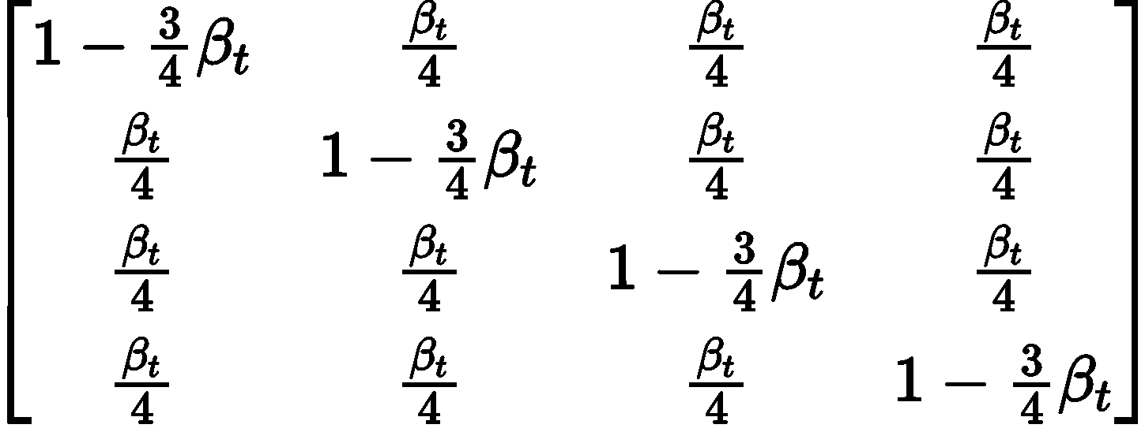
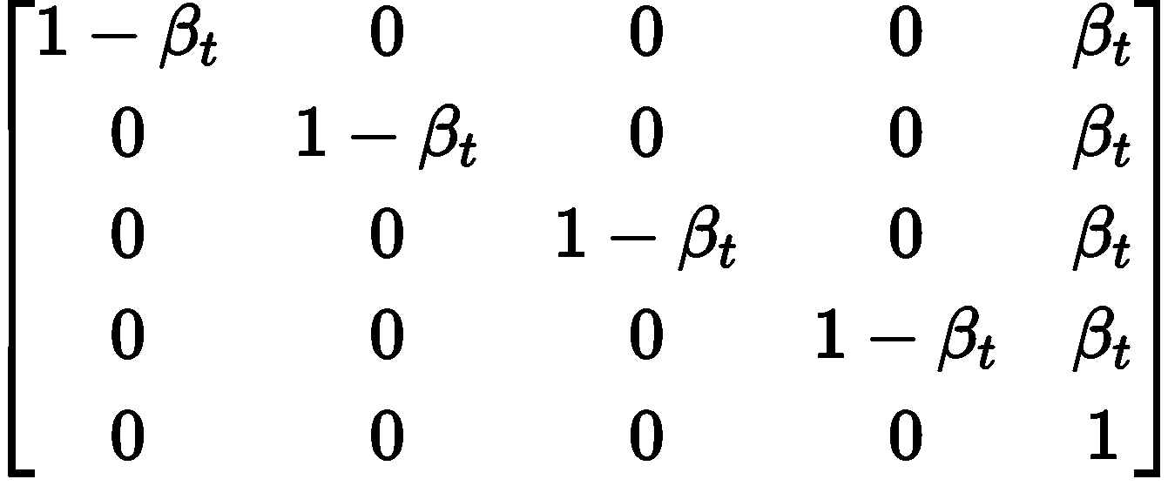

Transition matrices
Uniform transition, go to any state with equal probability
Absorbing transition, go to a [MASK] state $m$ with a probability $β_{t}$
where $e_{m}$ is a zero vector with index $m$ set to 1
Discretized Gaussian, useful for ordinal data
Token embedding distance, transition to a semantically close token (useful for natural language)
Uniform
Absorbing state
1
2
3
4
1
2
3
4
M
1 2 3 4
1 2 3 4 M
Notes:
How does the D3PM training work

Slide 13

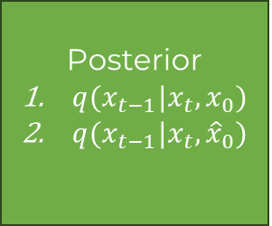



Forward and backward process during training
Posterior
$q(x_{t−1}|x_{t}, x_{0})$
$q(x_{t−1}|x_{t}, {\hat{x}}_{0})$
Variational Lower Bound
$$x_{0}$$
$$x_{t}$$
D3PM
$${\hat{x}}_{0}$$
$$Q_{t}$$
Loss
Cross-entropy
Notes:
Let’s look at some specifics for D3PM

Slide 14
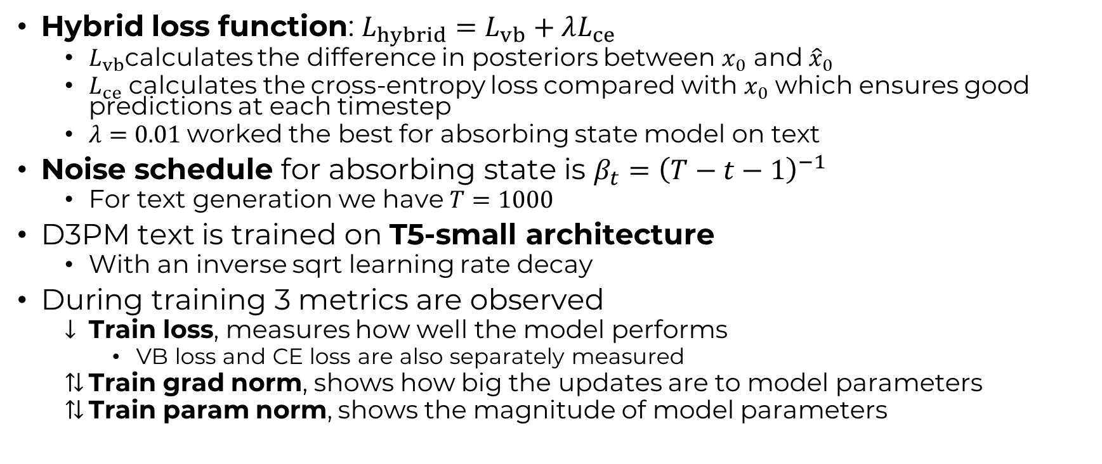
D3PM
Hybrid loss function: $L_{hybrid}=L_{vb}+λL_{ce}$
$L_{vb}$calculates the difference in posteriors between $x_{0}$ and ${\hat{x}}_{0}$
$L_{ce}$ calculates the cross-entropy loss compared with $x_{0}$ which ensures good predictions at each timestep
$λ=0.01$worked the best for absorbing state model on text
Noise schedule for absorbing state is $β_{t}={\left(T−t−1\right)}^{−1}$
For text generation we have $T=1000$
D3PM text is trained on T5-small architecture
With an inverse sqrt learning rate decay
During training 3 metrics are observed
Train loss, measures how well the model performs
VB loss and CE loss are also separately measured
Train grad norm, shows how big the updates are to model parameters
Train param norm, shows the magnitude of model parameters
Notes:
I can also show you a bit on this T5 architecture

Slide 15
Architecture? – T5
What do we want our architecture to do?
Given a corrupted sequence and a timestep give a slightly less corrupted sequence
BERT
Output: Probabilities of vocabulary of masked tokens and sequence context
Complexity: Less complex (only the encoder of a transformer)
Strength: Sequence understanding
GPT
Output: A sequence (tokens predicted one-by-one)
Complexity: Less complex (only the decoder of a transformer)
Strength: Sequence completion
Transformer (T5)
Output: Sequence to Sequence
Complexity: More complex
Strength: works well in our generative sequence setup (Does both sequence understanding and generation)
Transformer architecture used in other sequence diffusion models
D3PM, Diffusion Protein Language Model (DPLM)
BERT also used in sequence diffusion models
DiscDiff, Protein Design with Guided Discrete Diffusion, Dnabert, DiffBert

Slide 16
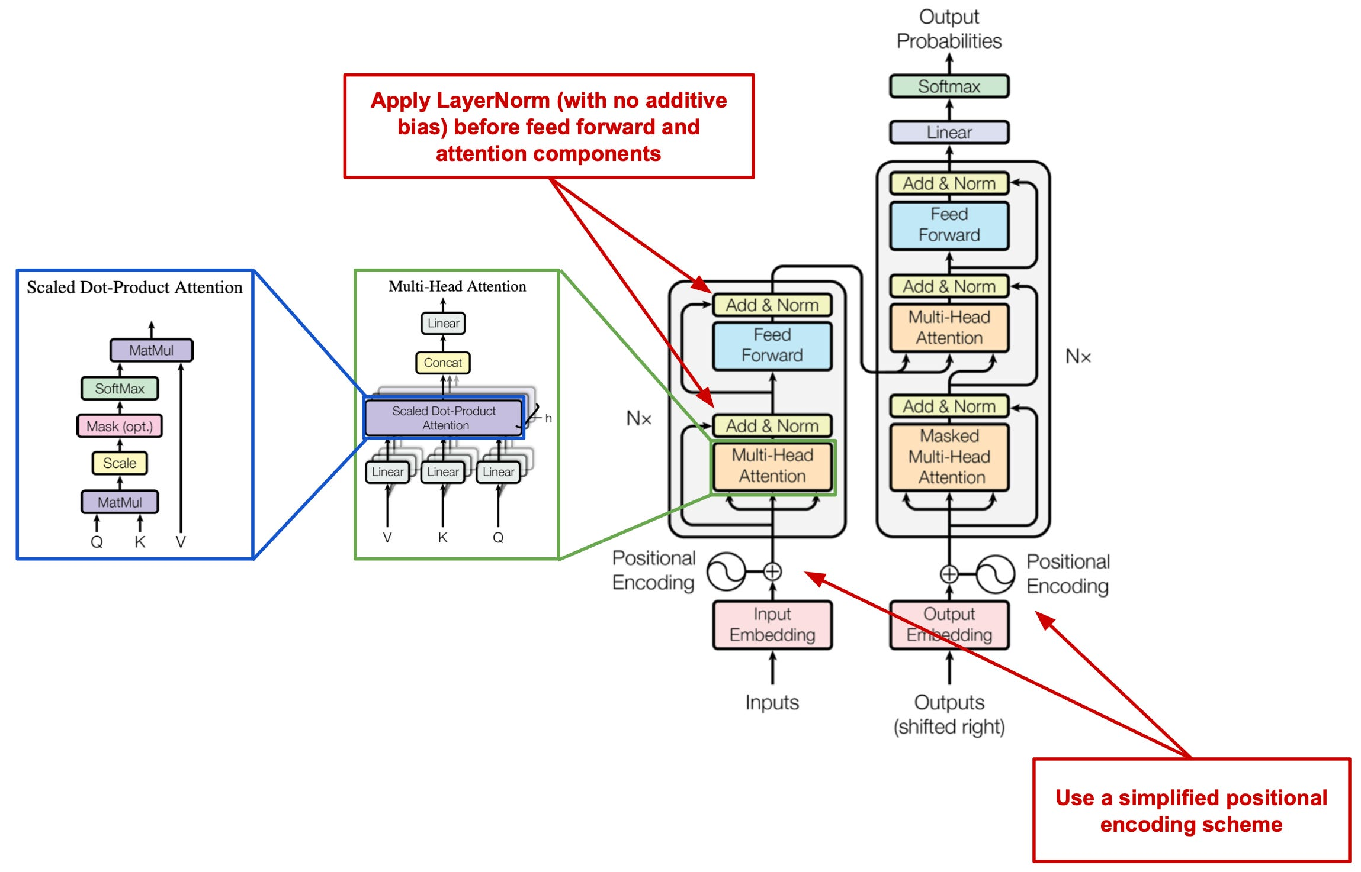
T5 – How is it different
Layer normalization is simplified for better training efficiency and stability
Relative positional encoding aids with longer sequences
Dropout regularization used throughout the network
Image taken from: https://cameronrwolfe.substack.com/p/t5-text-to-text-transformers-part
Notes:
T5 is an adaption to the famous standard sequence-to-sequence model the transformer
How do we train on this architecture?

Slide 17



Training on T5
One-hot encode sequence to obtain shape (b, K, N)
Encoder input is optional as its used for conditioning information
Target
$$x_{0}$$
$$x_{t}$$
Corrupt
Encoder
t
Decoder
Input
logits
$$x_{0}$$
enc
inputs
length
logits
Predict length
Optional
Notes:
Encoder is used for conditioning, and we are not going to use it
Now some small details on the timestep embedding

Slide 18


T5 with timestep embedding
Decoder
$$x_{t}$$
t
Timestep-EmbedBlock
FiLMBlock
T5 Decoder Layer
Embedder
logits
$$x_{0}$$
n layers
Notes:
How do these FiLM blocks look like?

Slide 19
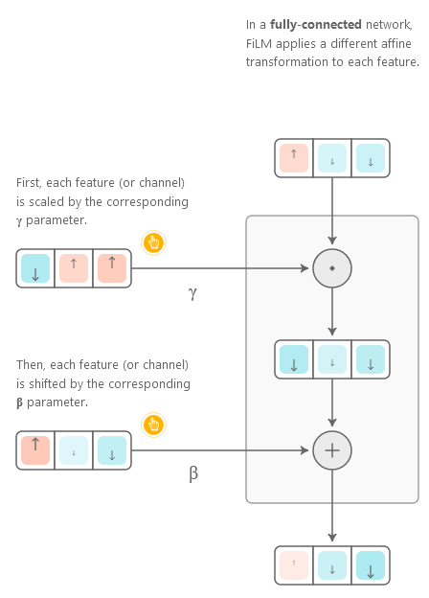
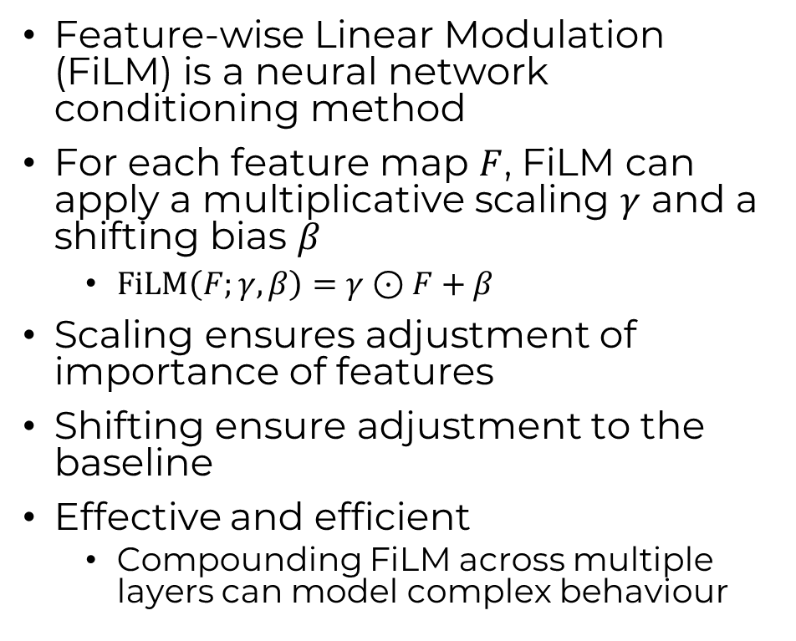
FiLM layer
Feature-wise Linear Modulation (FiLM) is a neural network conditioning method
For each feature map $F$, FiLM can apply a multiplicative scaling $γ$ and a shifting bias $β$
$FiLM\left(F;γ,β\right)=γ⊙F+β$
Scaling ensures adjustment of importance of features
Shifting ensure adjustment to the baseline
Effective and efficient
Compounding FiLM across multiple layers can model complex behaviour

Slide 20
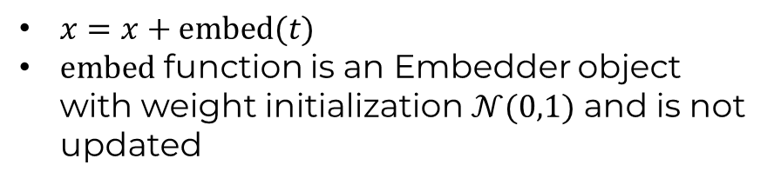
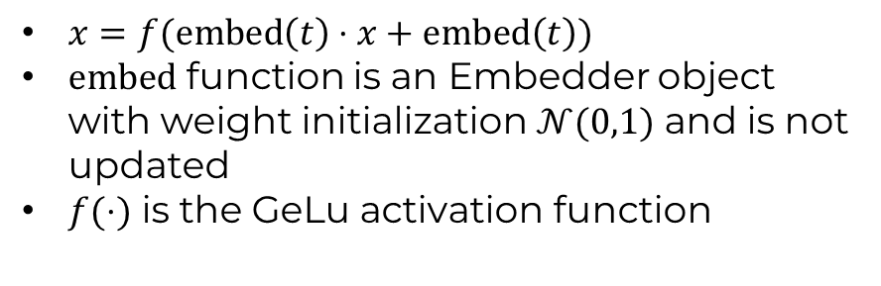
Feature-wise Linear Modulation (FiLM)
Decoder
Timestep-EmbedBlock
$x=x+embed(t)$
$embed$ function is an Embedder object with weight initialization$𝒩(0,1)$ and is not updated
Timestep-EmbedBlock
FiLMBlock
T5 Decoder Layer
Embedder
FiLMBlock
$x=f(embed\left(t\right)⋅x+embed\left(t\right))$
$embed$ function is an Embedder object with weight initialization$𝒩(0,1)$ and is not updated
$f(⋅)$ is the GeLu activation function
n layers
Notes:
We baseline with TimestepEmbedBlock
We keep introducing timestep in each layer
How does generation or sampling work in our setup

Slide 21
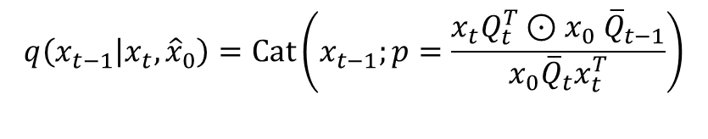

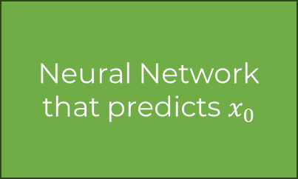

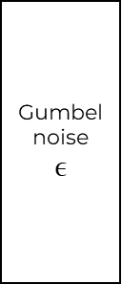
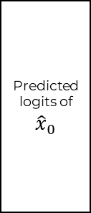
Sequence Generation
shape (b, K, N)
$$q\left(x_{t−1} | x_{t},{\hat{x}}_{0}\right)=Cat\left(x_{t−1};p=\frac{x_{t}Q_{t}^{T}⊙x_{0} {\overline{Q}}_{t−1}}{x_{0}{\overline{Q}}_{t}x_{t}^{T}}\right)$$
$$x_{t}$$
Predicted logits of ${\hat{x}}_{0}$
Posterior
Gumbel-Max trick
$$x_{t−1}$$
Neural Network that predicts $x_{0}$
+
argmax
Adding noise allows for stochastic sampling
Gumbel distribution is used to model the distribution of the maximum of a number of samples of various distributions.
Gumbel-Max trick is reparameterization of SoftMax over stochastically sampled points
Gumbel noise
$$ϵ$$
Notes:
Let’s look at some early results

Slide 22
Similarities to existing probabilistic models
BERT is a one-step D3PM
BERT applies a sequence transformation with 10% absorbing state and 5% uniform transitions
Masked Language Models (MLMs) is multi-step D3PM
Absorbing state D3PM with the ELBO objective can be rewritten as a reweighted MLMs objective function
Autoregressive models can be framed as deterministic D3PM
Where we mask tokens one-by-one and each token is predicted based on the previous ones

Slide 23
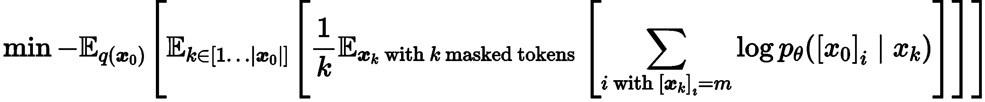
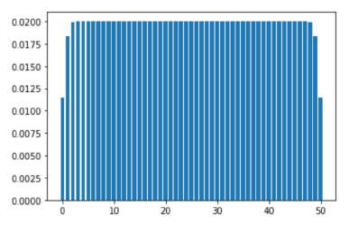
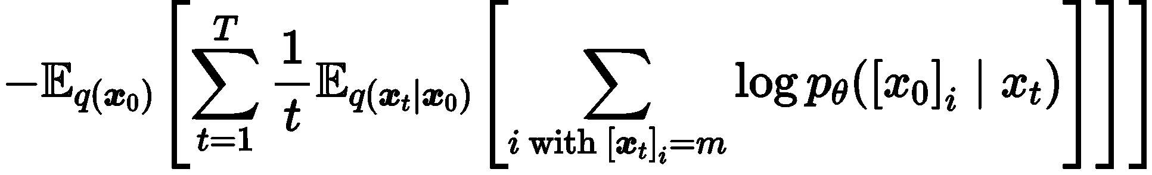

Similarities to MLM
Generative Masked Language Models (MLMs) mask $k$ tokens
Objective MLMs
Objective of D3PM can be simplified (when using a reparameterization)
Unmasked tokens have a KL-divergence of 0
Masking transitions in KL-divergence set to constant (not dependent on $θ$)
Taking noise schedule $β_{t}=1/(T−t+1)$
New objective
Masking is computed independently with a reweighted version
Mask each token with a reweighted prob $p≈k/T$
Similar to a mixture of binomials

Slide 24
First results on images using UNet
Notes:
This is what the code does out of the box on images
How does the code work out of the box on sequences?

Slide 25
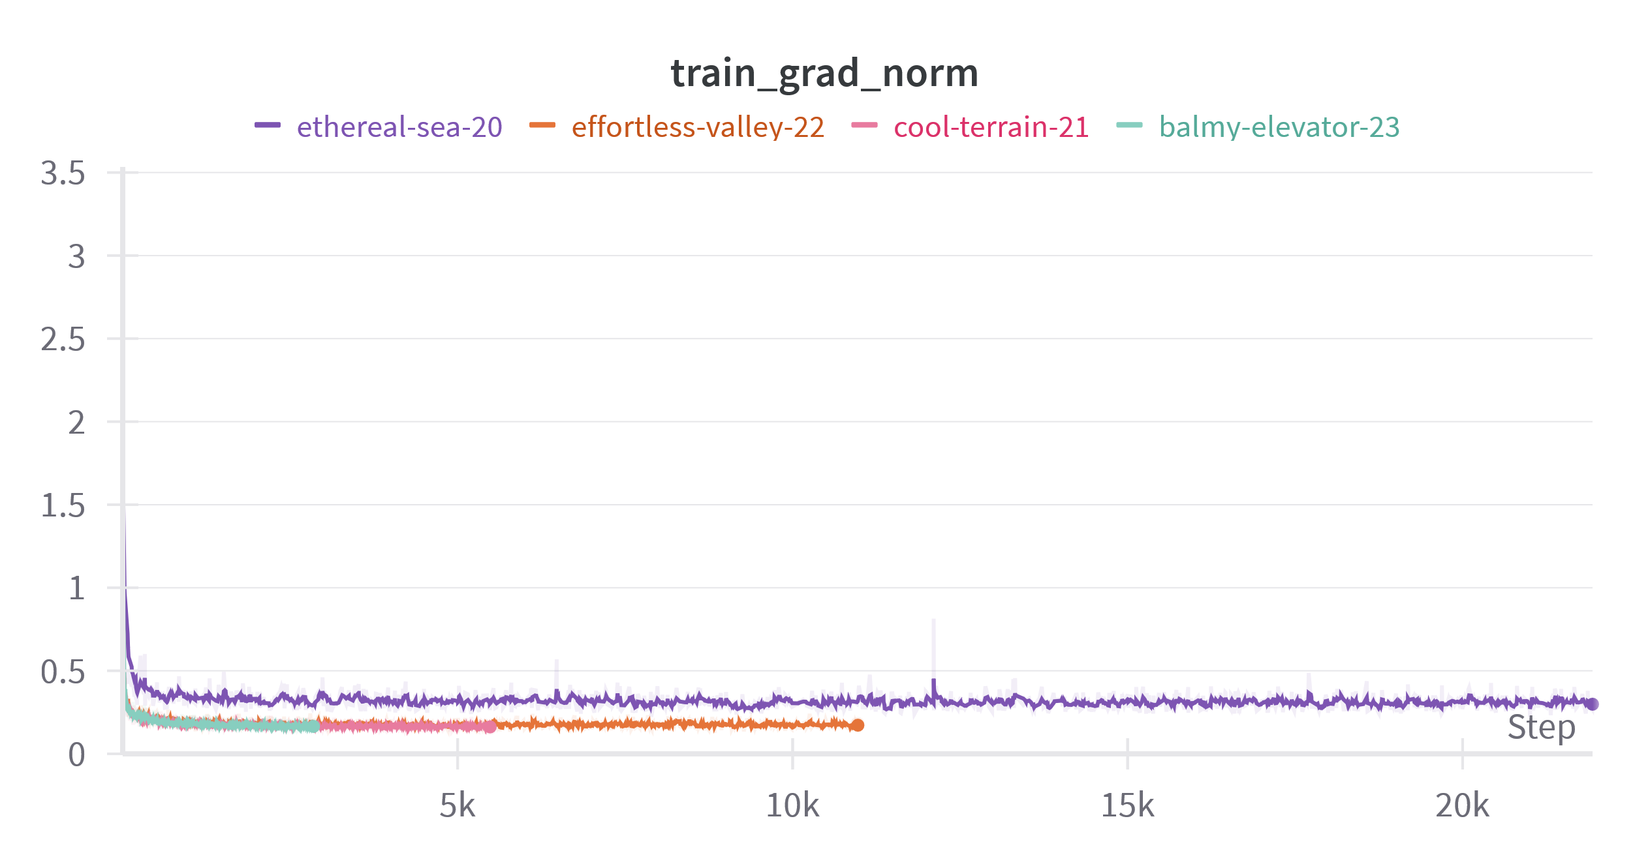
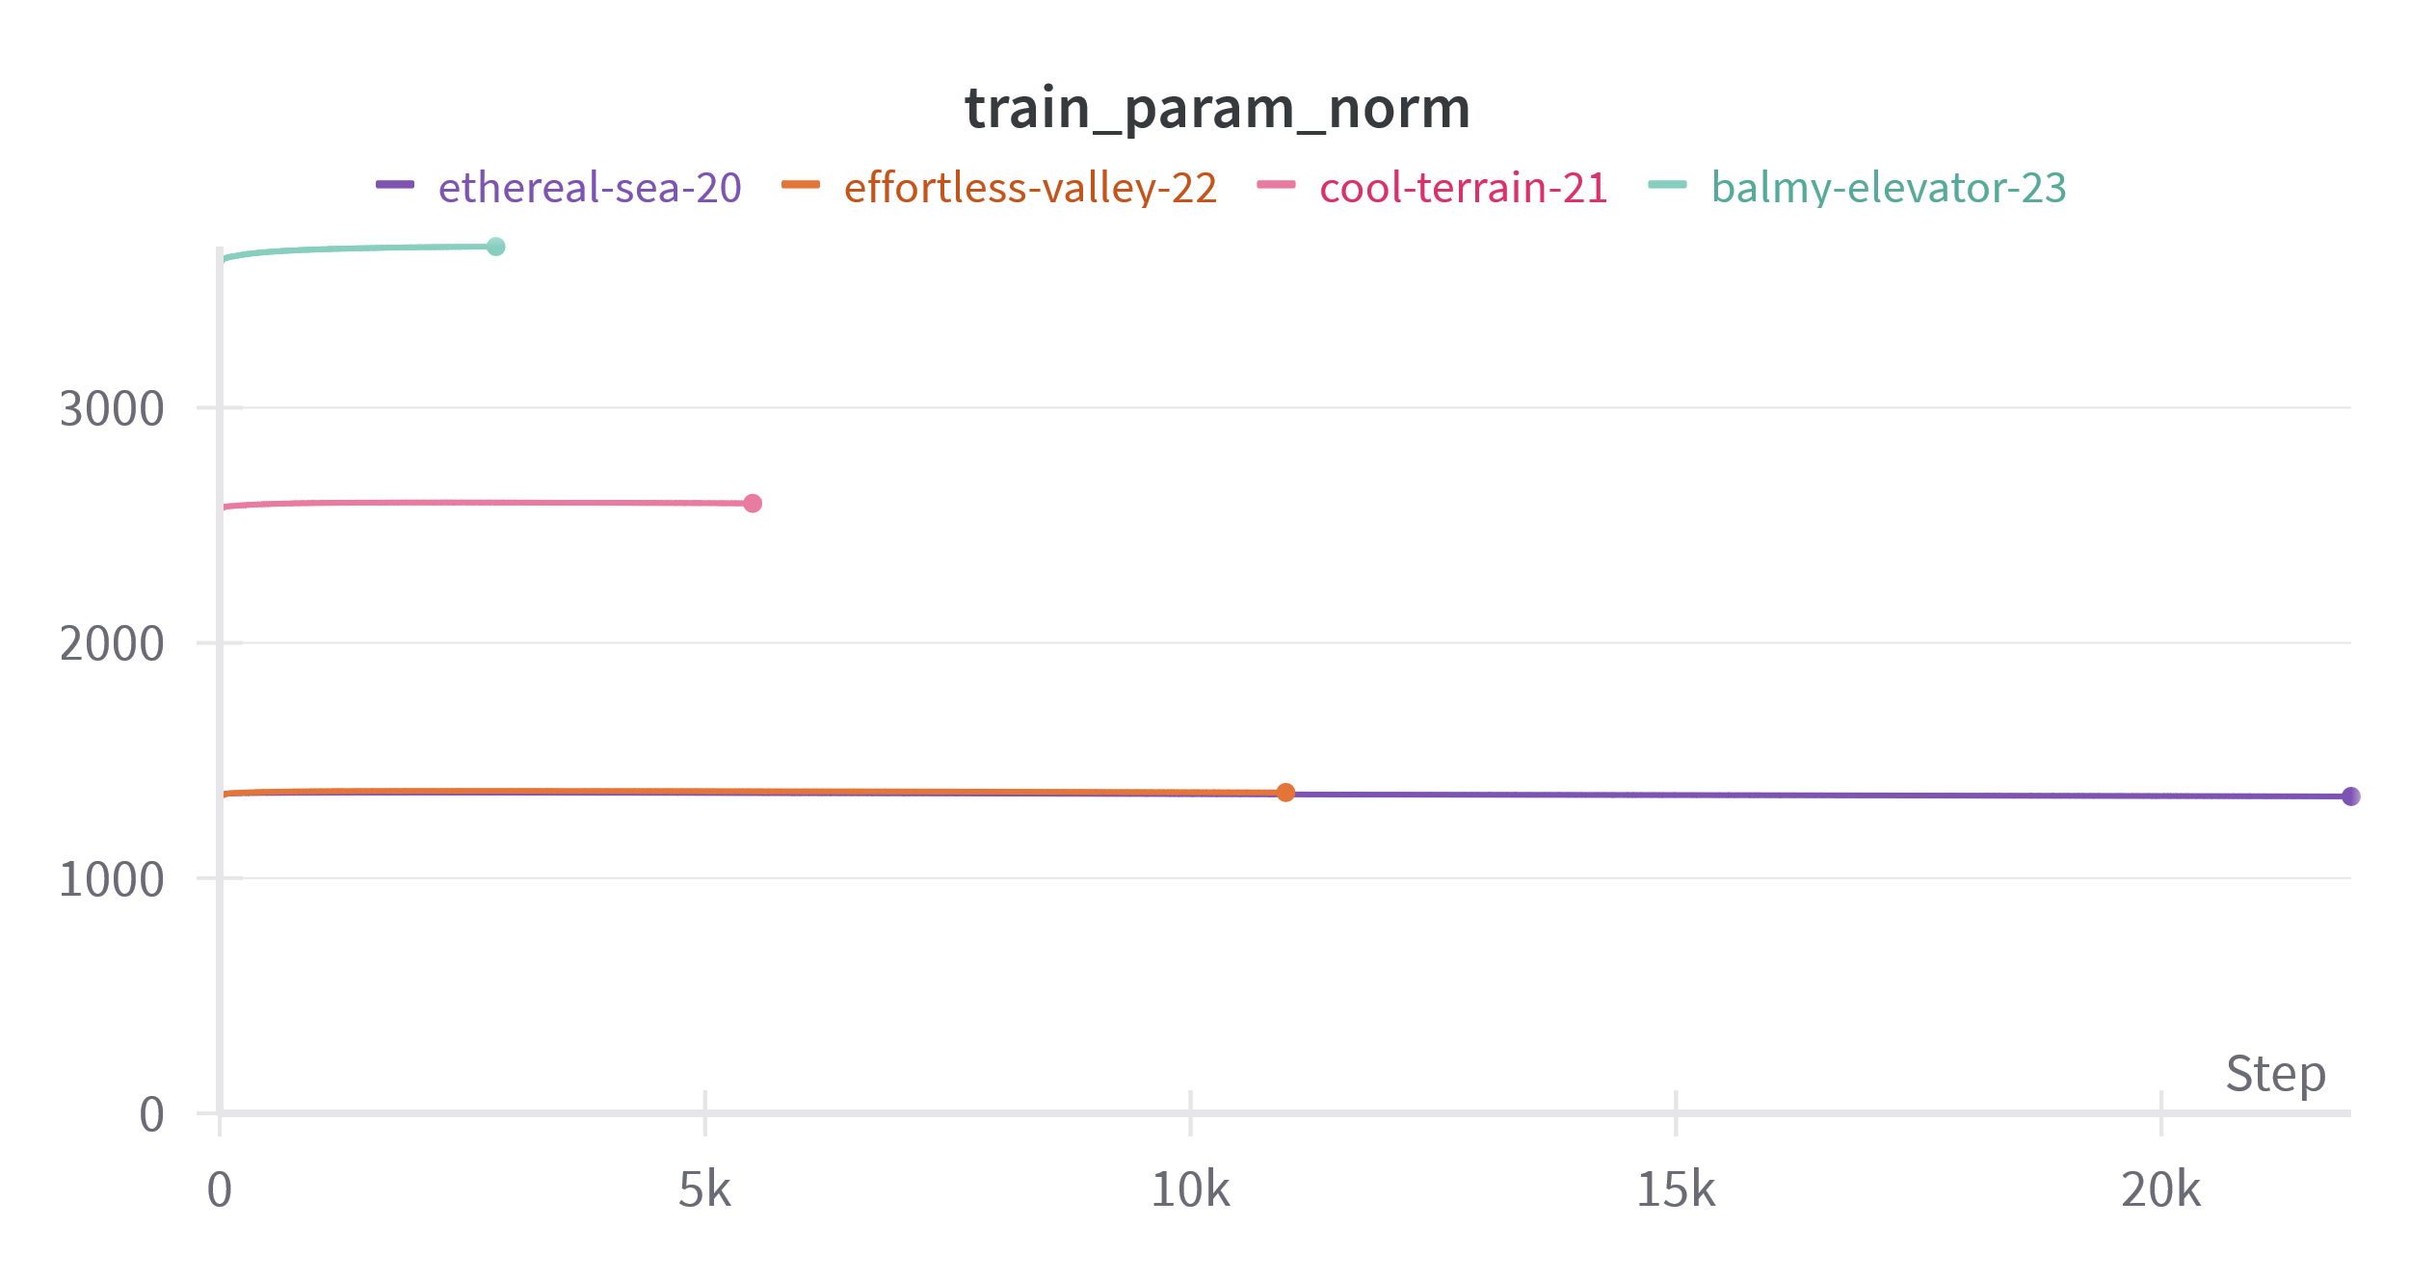
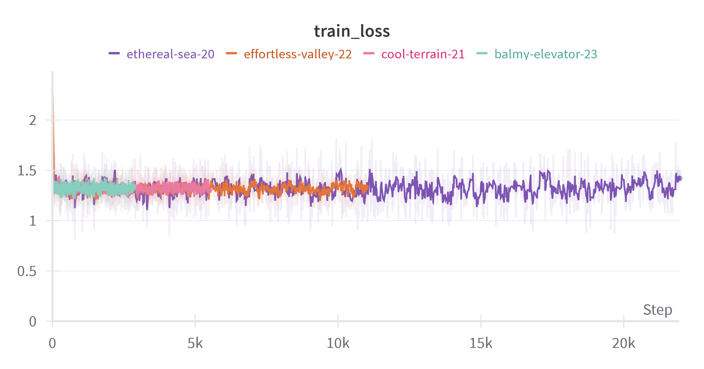
Initial results on UniRef50 using DDiTLlama
Ethereal-sea
Batch size = [32]
Embedding dimension = [384]
# Layers and heads = [6]
Epochs = [5]
Effortless-valley
Batch size = [128]
Embedding dimension = [384]
# Layers and heads = [6]
Epochs = [10]
Cool-terrain
Batch size = [128]
Embedding dimension = [384]
# Layers and heads = [12]
Epochs = [5]
Balmy-elevator
Batch size = [128]
Embedding dimension = [768]
# Layers and heads = [12]
Epochs = [5] (only did 2.6 epochs)
Notes:
Not that much happening but we are using a different architecture

Slide 26
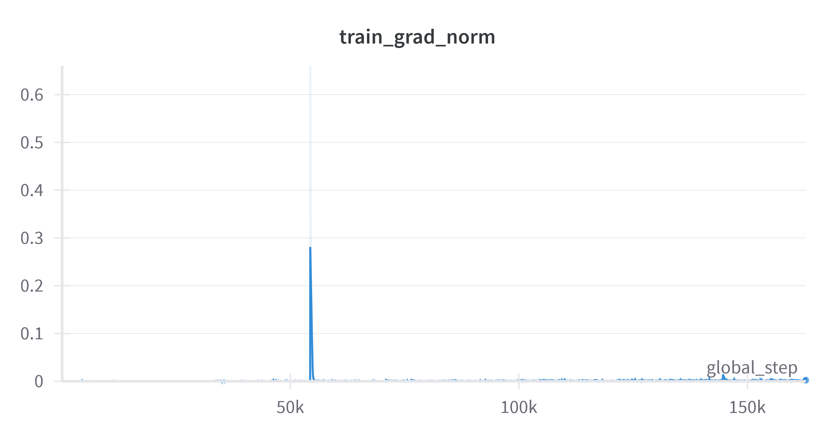
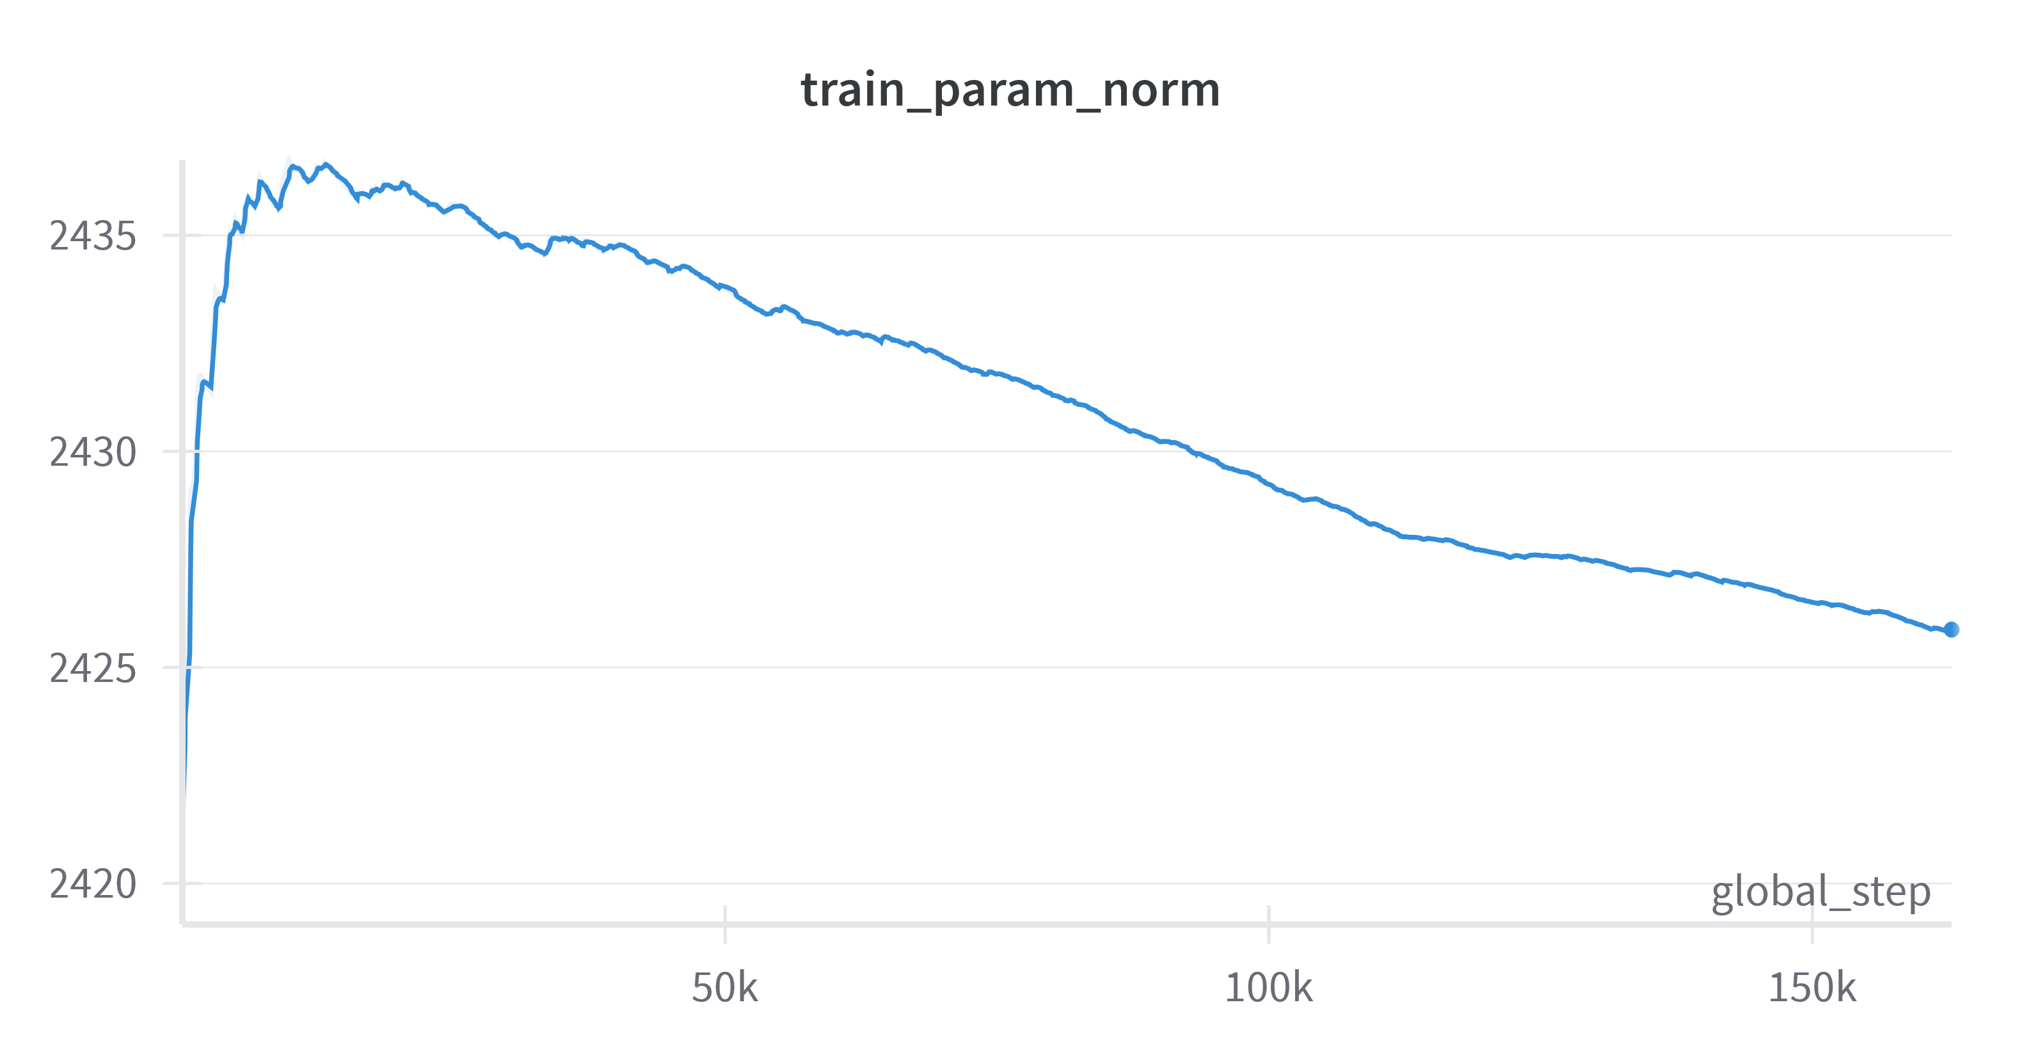
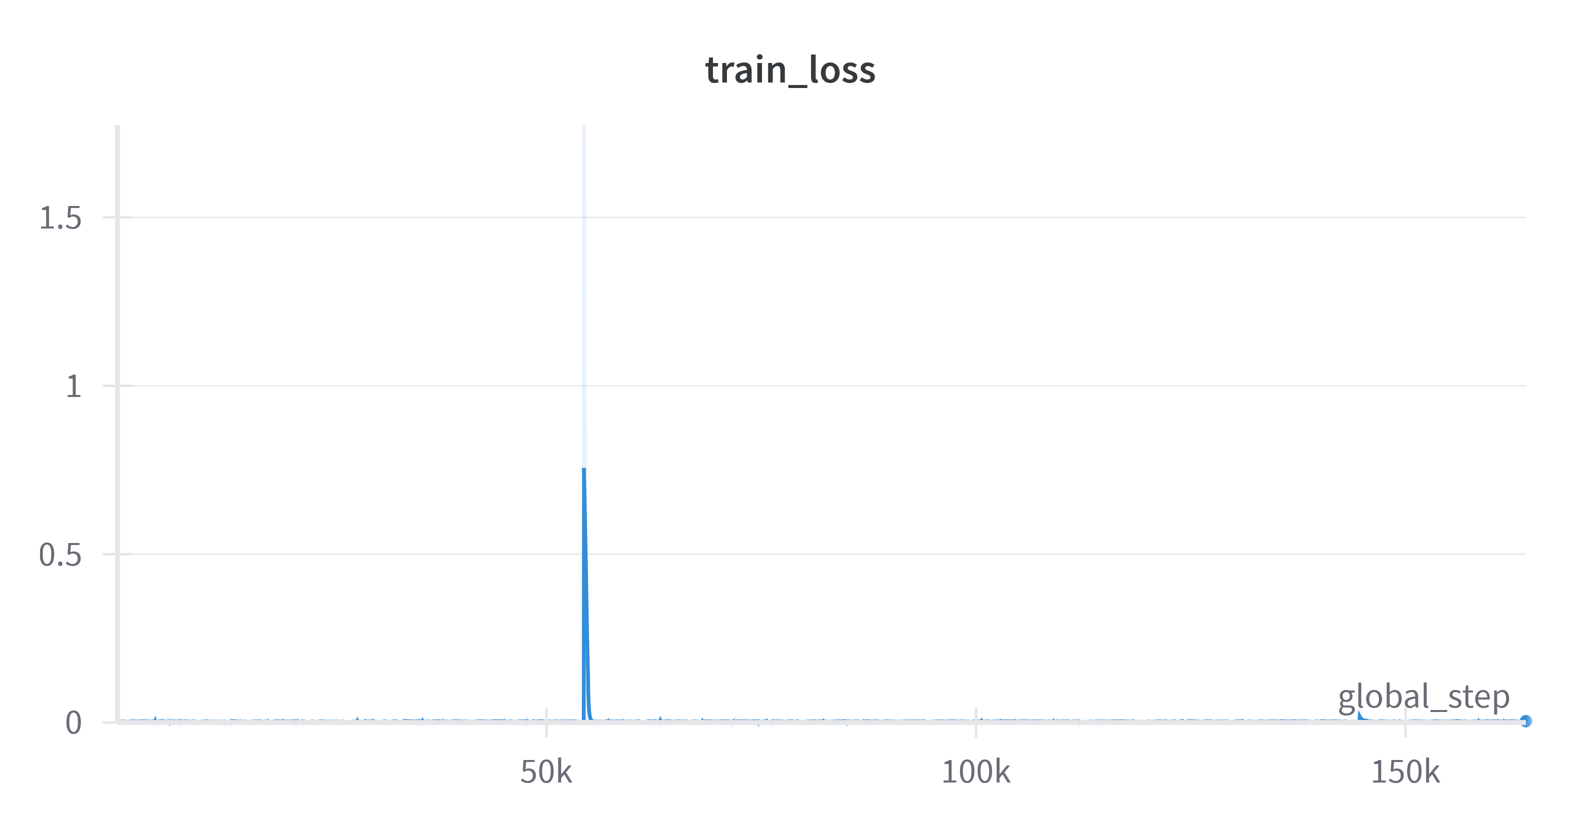
Initial training on UniRef50 using T5
Notes:
This is some early early results where I tested the model's performance using batch size 1
More test need to be done to fully debug model and do hyperparameter search

Slide 27
Future work
Train aa sequences successfully on T5
Implement absorbing state
Implement reparameterization of reverse process
Speeds up training and sampling

Slide 28
Questions?

